Slide 1
Secure Student Management System(DevSecOps)
Security Testing and Assurance

Slide 2
System Overview & Scope
Web-based Student Management System (Flask + SQLAlchemy).
Roles: Admin • Teacher • Student (least-privilege RBAC).
Core scope: Authentication, CRUD, dashboards, secure APIs.

Slide 3
Technological Stack Used
Programming & Framework
Backend Language:
Python Web Framework: Flask (lightweight, secure, easy integration with extensions)
ORM (Database Layer): SQLAlchemy
Form Handling: Flask-WTF (for CSRF protection & validation)
Frontend Technology
HTML, CSS, JavaScript, Bootstrap for responsive User Interface

Slide 4
Technological Stack Used
Database & Storage
SQLite (development)
Encryption: Fernet (AES) from cryptography library for sensitive fields
Password Hashing: bcrypt (salted hashing for secure password storage)
Deployment & Infrastructure
Containerization for GitHub actions: Docker
Server Environment: Ubuntu / GitHub Runner

Slide 5
Security Controls (OWASP-focused)
Authentication & Access
bcrypt password hashing
2FA (TOTP/email OTP)
RBAC with role-scoped routes
Input & Transport
CSRF tokens on state-changing requests
Output encoding/CSP to reduce XSS
TLS in transit
Data & Secrets
Field-level encryption for
Secret management via .env variables (no hardcoding)

Slide 6
DevSecOps Pipeline
GitHub Actions triggers on push/Pull Requests
Quality & Security gates: ruff/pytest → SAST (SonarQube) → SCA → ZAP (DAST)
Fail fast on critical errors
artifacts archived (logs, reports)

Slide 7
Features
Registration, Login, Logout
2FA via Email OTP (also always printed in console)
RBAC (admin, teacher, student)
CRUD for Students (admin/teacher) and Teachers (admin)
AES encryption (Fernet) for sensitive fields (student address)
JWT API for programmatic access (/api/login, /api/students GET/POST)
Audit Logging to logs/audit.log
Analytics Dashboard (grade distribution with Chart.js)
Encrypted Backup/Restore of SQLite DB
Sample Data (admin/teacher/student users + students/teachers)

Slide 8
CI/CD Gates
Unit/integration tests must pass (pytest).
SAST Quality Gate: no new Critical/Blocker issues.
Dependency & secrets scans: block on High/Critical.
DAST baseline: block on High risk alerts.

Slide 9
2FA & Session Security
TOTP via PyOTP or email OTP fallback.
Backup/recovery paths and rate limiting.
Short session time to live(TTL)
re-authorization for sensitive actions.

Slide 10
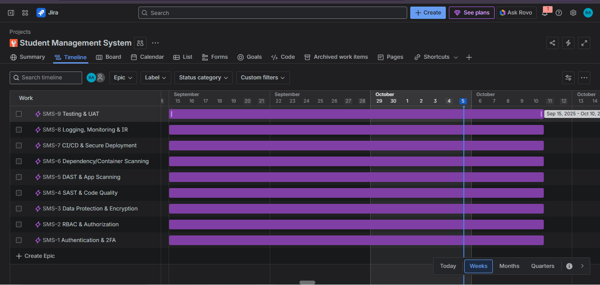
Jira Project Timeline

Slide 11
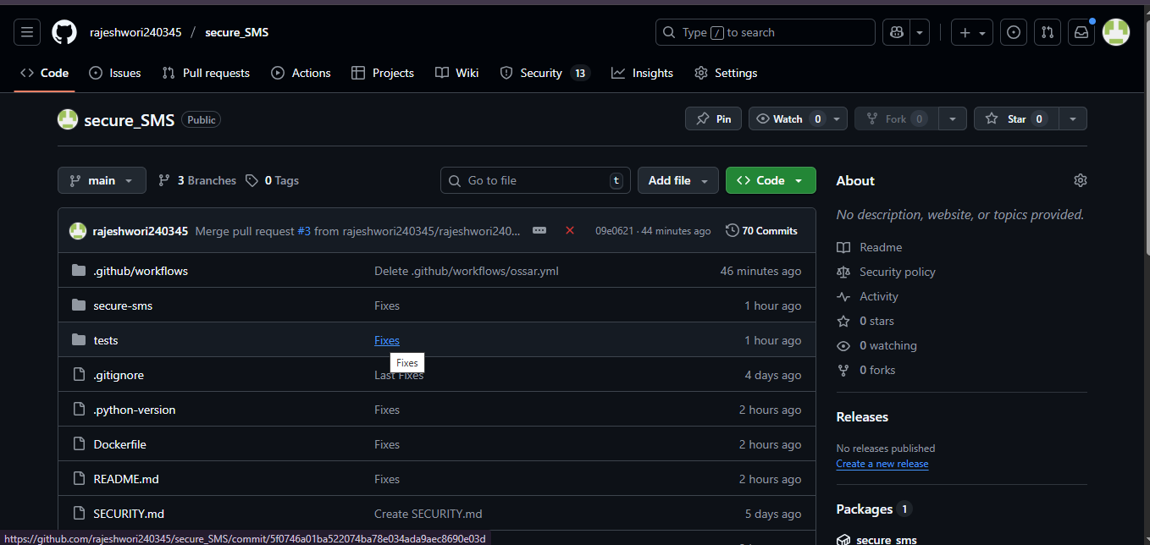
GitHub Repository Layout

Slide 12
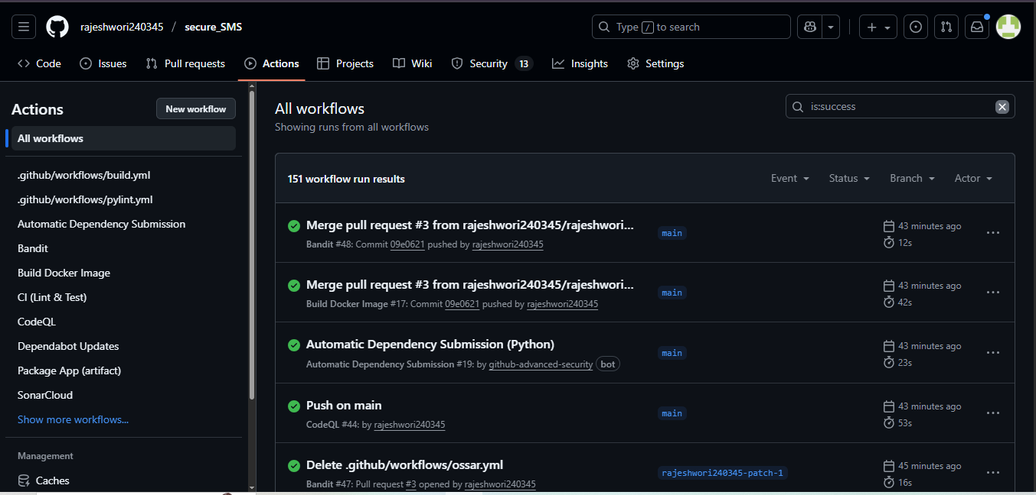
Security Scans in CI/CD pipeline

Slide 13
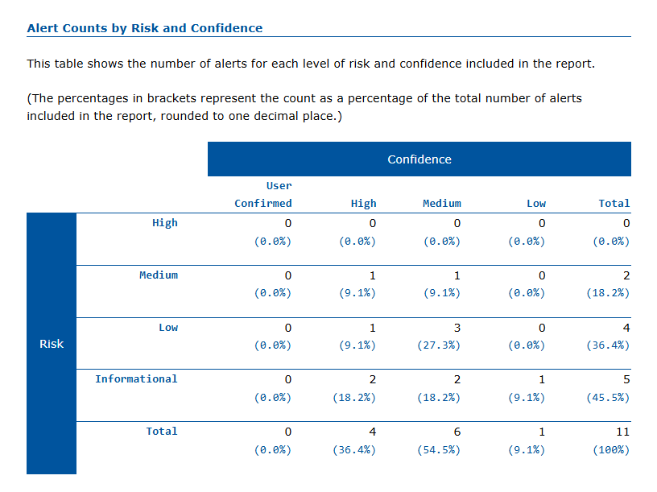
DAST Scan (OWASP ZAP Scan)

Slide 14
Testing Results (Summary)
Unit/Integration: authentication, Role Based Access Control (RBAC), Create, Read, Update, Delete Operations(CRUD), Two Factor Authentication(2FA) flows was verified.
Dynamic Application Security Testing(DAST) findings were tuned and no critical vulnerability remain at final run
Static Application Security Testing(SAST) hotspots were reviewed and false positives documented with SonarQube, bandit

Slide 15
What Worked Well
Shift-left security reduced last-minute fixes.
Automated gates kept main branch stable.
Structured logging sped up troubleshooting.

Slide 16
Challenges & How We Solved Them
Noisy first scans(False Positives) → tuned rules & triage playbook.
Secrets in history → rotation & pre-commit scanning.
Encrypt-at-rest complexity → prioritized critical fields first.

Slide 17
Future Enhancements
Passkeys/biometric authentication
CAPTCHA on auth endpoints.
Advanced monitoring (SIEM) & incident simulations.
Content Security Policy (CSP) hardening
mobile application / API expansion.

Slide 18
Key Learnings from the Project
Integrated security from the start rather than as a final step.
Adopted DevSecOps principles to “shift security left,” catching vulnerabilities early.
Built and automated a CI/CD pipeline using GitHub Actions, SonarQube (SAST), and OWASP ZAP (DAST).
Learned how automation enforces continuous testing, scanning, and secure deployment.

Slide 19
Key Learnings from the Project
Implemented bcrypt hashing and Fernet encryption (AES) for data protection.
Applied input validation and CSRF/XSS/SQLi prevention for robust application security.
Understood the value of peer code reviews and collaborative development.
Gained hands-on experience with JIRA, SonarQube, Dependency-Check, and GitHub Actions.

Slide 20
Key Learnings from the Project
Learned how these tools integrate into a modern DevSecOps workflow.
Recognized that security continues after deployment through logging, alerts, and monitoring.
Developed a basic Incident Response Plan for detection, containment, and recovery.
Enhanced teamwork across Development, Security, and Operations roles.

Slide 21
Key Learnings from the Project
Adopted a continuous feedback culture where every commit and scan improves security posture.
Designed strong controls like 2FA without harming user experience.
Learned that secure systems can still be simple, intuitive, and user-friendly

Slide 22
The End

